Slide 1

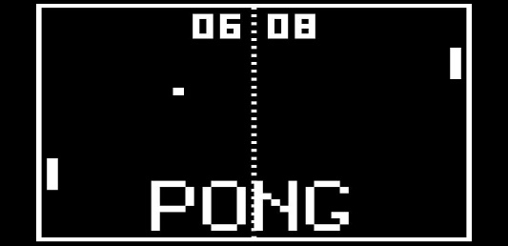
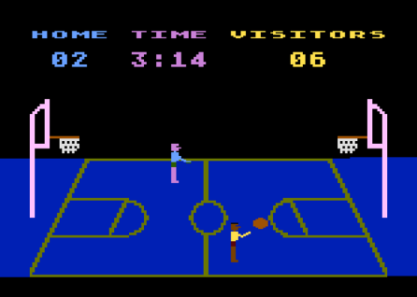
Q-Reinforcement Learning Rock, Paper, Scissors – Amari Lawal
Summary
GitHub Repo: https://github.com/Amari-Lawal/Baes-System-Project.git
My projects goal was to implement q-reinforcement learning into the rock paper scissors game. What does this jargon mean you must be thinking? The program creates a CPU bot/agent that learns how to play rock paper scissors as it plays, as a result making an unstoppable player that will always beat you for the last slice of pizza at a party!
Originally the plan was to make an interactive game with Player vs CPU however the code I wrote in order to test the code, wasn’t in the right format and I wasn’t able to change it in time. Slight reformatting and I would be able to implement it. However for now, I made one CPU that made completely random moves in order to mimic the players part and the Q CPU that would learning as it went. If I had implemented a Player vs CPU game then it would have been an entertaining game of average difficulty against the Q CPU.
The most refreshing part of this project is knowing that the knowledge I gained from these projects have extremely strong applications to many things with large flexibility in methods. Allowing me to change things to my specific purpose. One thing I enjoyed oddly enough, was the longer run times in my code. It made me feel like I was building this super sophisticated system that implements extreme mathematical algorithms, yet it was a simple rock paper scissors game. Whilst at the same time withheld considerable complexity.
One problem I came across consistently was that the same seed was being produced(as you can see in overall_results.csv) with the exact number of wins each iteration. Which is anomalous for an algorithm that runs off of randomness. I managed to solve it by shuffling the data but got a negative result each time, however the runs would vary from the Q CPU having more wins then sometimes the opponent CPU having more which managed to sort itself out in the end.

Slide 2
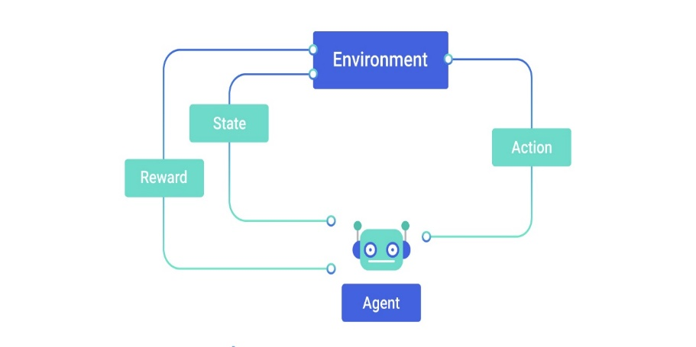
Q-Reinforcment Learning Rock, Paper, Scissors – Amari Lawal
Research
During the research process I learned the mathematical and programmatical processes that run when creating a reinforcement learning Agent. Whilst, being connected to an environment to make the game interactive. Although I didn’t implement an environment in this project.
Initially, learning the Q-learning concepts in a few hours was the hardest part in the project. Especially compared to most machine learning and deep learning techniques there was a lot more code, maths and a better understanding of the techniques required. With very minimal documentation and very little API support. As a result I had to learn how to hard code it from scratch and implement the algorithm in the right format and output it correctly to fit my game.
Most complex game CPU characters: Dark souls, Forza and God of War run off of reinforcement learning agents that follow similar principals with larger complexity.
This research made me come to the realization on how amazing and complex game development is. Seeing I managed to struggle with a rock paper scissors game, the complexity that may come with A.I driven characters is fascinating. Having the skill to create these characters and having the freedom to dictate the A.I’s difficulty is astonishing.
I used this site to help me understand the theory and how to use the algorithm equation:
https://towardsdatascience.com/a-beginners-guide-to-q-learning-c3e2a30a653c
And several research papers:
Google Scholar: q learning reinforcement learning

Slide 3

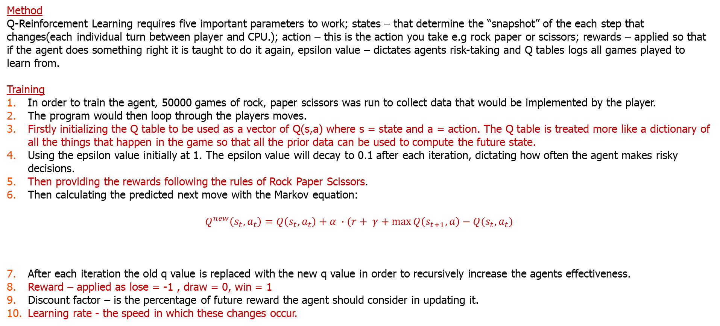
Q-Reinforcement Learning Rock, Paper, Scissors – Amari Lawal
Method
Q-Reinforcement Learning requires five important parameters to work; states – that determine the “snapshot” of the each step that changes(each individual turn between player and CPU.); action – this is the action you take e.g rock paper or scissors; rewards – applied so that if the agent does something right it is taught to do it again, epsilon value – dictates agents risk-taking and Q tables logs all games played to learn from.
Training
In order to train the agent, 50000 games of rock, paper scissors was run to collect data that would be implemented by the player.
The program would then loop through the players moves.
Firstly initializing the Q table to be used as a vector of Q(s,a) where s = state and a = action. The Q table is treated more like a dictionary of all the things that happen in the game so that all the prior data can be used to compute the future state.
Using the epsilon value initially at 1. The epsilon value will decay to 0.1 after each iteration, dictating how often the agent makes risky decisions.
Then providing the rewards following the rules of Rock Paper Scissors.
Then calculating the predicted next move with the Markov equation:
$$Q^{new}\left(s_{t},a_{t}\right)=Q\left(s_{t},a_{t}\right)+α ∙(r+ γ+\max{Q\left(s_{t+1},a\right)}−Q(s_{t},a_{t})$$
After each iteration the old q value is replaced with the new q value in order to recursively increase the agents effectiveness.
Reward – applied as lose = -1 , draw = 0, win = 1
Discount factor – is the percentage of future reward the agent should consider in updating it.
Learning rate - the speed in which these changes occur.
$∆$difference state change
new Q value
old Q value
reward
learning rate
discount factor
old Q value
estimate of future value

Slide 4
Q-Reinforcment Learning Rock, Paper, Scissors – Amari Lawal
Future Plans
After this program I plan to explore reinforcement learning more so that I can escalate to researching into creating games, software and engines with higher complexity, with techniques I have learned this week. In order to undergoes more complex tasks,using these skills for both my own recreation and in the work place.
My interest has always lied in machine learning for cybersecurity and applying to this program has helped me to learn how best to integrate the two. I’m looking forward to potentially working with baes systems in the future. Hopefully applying to the apprenticeship at the end of sixth form in cybersecurity or machine learning, further learning more to integrate into real-world situations and problems.

